Slide 1
Laravel Controller and Usage
Course Code: CSC 4182
Course Title: Advanced Programming In Web Technologies
Dept. of Computer Science
Faculty of Science and Technology
Lecture No: | 13 | Week No: | 09 | Semester:
Lecturer: | Tanvir Ahmed; tanvir.ahmed@aiub.edu

Slide 2
Lecture Outline
Creating Controllers
Loading view from controller
Data Passing: Controller to View
Blade syntaxes in views
Data Passing: Views to Controller
Advanced Routing

Slide 3
Creating Controllers
Topic sub heading..
Instead of defining all the requests in route closure its better to group them in another place. Its more organized.
Controllers can group related request handling logic into a single class.
Controllers are stored in the app/Http/Controllers directory.
Controller extends the base controller class included with Laravel.
The base class provides a few convenience methods such as the middleware method, which may be used to attach middleware to controller actions.
To create controller you can go to app/Http/Controllers and create a controller file with .php extension.
You need to write a class of your own.
Your controller class should extend the default controller class.
Laravel also provides an artisan command that automatically creates a controller for you. (Open cmd in project and run the command)
php artisan make:controller your_controller_name
php artisan make:controller PagesController

Slide 4
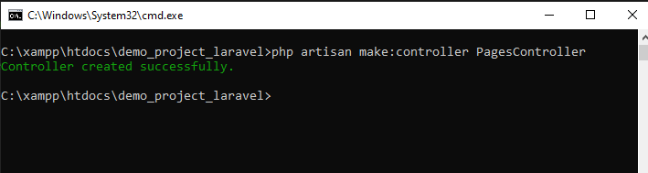
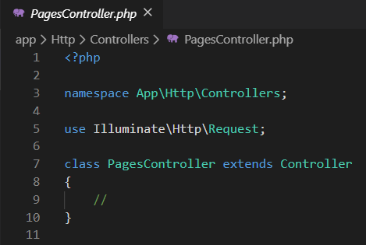
Creating Controllers

Slide 5
Loading View from Controller
Previously we were loading views from the route directly with Closure. Now we will bind controllers method with route Closure and load the view.
Write a function in Controller.
function Hello(){
return view("hello");
}
This function will return the view residing in resources/views/hello.blade.php
Now to bind the function with route( go to web.php)
Route::method('route','ControllerName@ControllerFunction');[General Syntax]
Route::get('/hello','PagesController@hello');
So the steps are
Create a controller in app/Http/Controllers/
Create a view in resources/views/ with .blade.php extension
Write a function in controller to load the view
Create a route in routes/web.php and bind the controller function

Slide 6
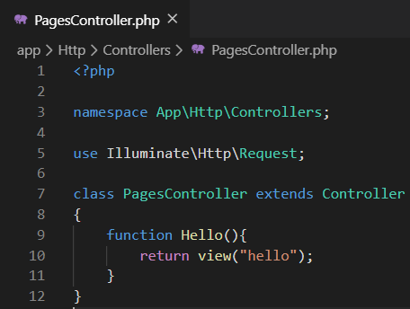
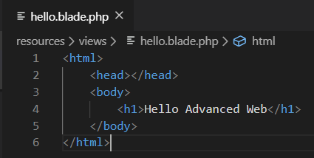
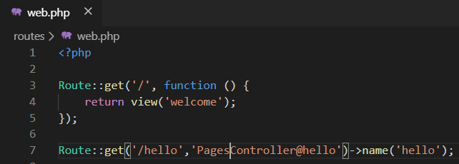
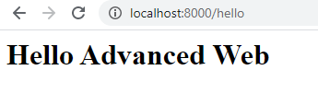
Loading Views from Controller
Views
Controller
Route
Output

Slide 7
Data Passing: Controller to View
As most of the cases controller functions will be responsible for database operations and calculations, we will be needing to pass data from controller to views to build dynamic web applications.
Values can be passed with an associative array and the passed values can be retrieved with the key in blade files.
return view('filename', ['key' => 'Value' , 'key' => 'Value']); //Passing value
<?php echo $key; ?> //retrieving in blade
As an alternative to passing a complete array of data to the view helper function, you may use the with method to add individual pieces of data to the view.
return view('filename')->with('blade_key', 'value'); //Passing value
You may display the contents of the variable like so
Hello, {{ $name }}.
Instead of using
Hello, <?php echo $name; ?>
By default, Blade {{ }} statements are automatically sent through PHP's htmlspecialchars function

Slide 8
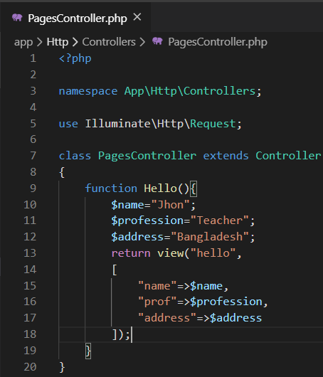
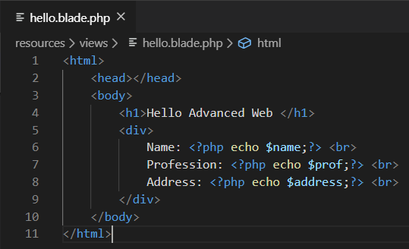
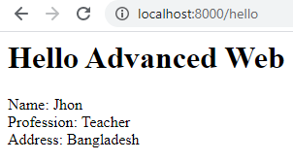
Passing Data to View [Associative Array]
Using them in views
Passing the value
Output

Slide 9
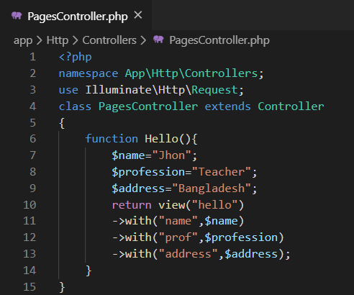
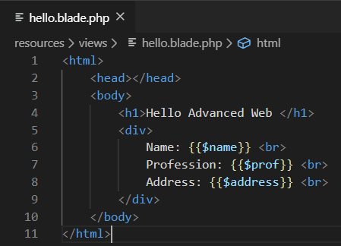
Passing Data to View [with function]
Shortcut to echo variable
Passing the value
Output

Slide 10
Blade Syntaxes in Views
Topic sub heading..
Echo data
{{ $variable }}
If else
@if (condition)
Statement
@elseif (condition)
Statement
@else
Statement
@endif
For loop
@for($i=0; $i<$length; $i++)
Staement
@endfor
Foreach loop
@foreach ($array as $element)
{{$element->property}}
@endforeach
While loop
@while (condition)
Statement
@endwhile
Including other views
@include('view’)
Defining master layout and extending those will be discussed later.

Slide 11
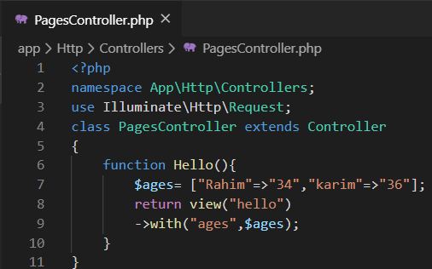
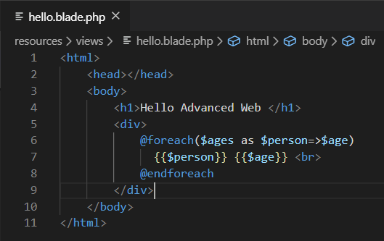
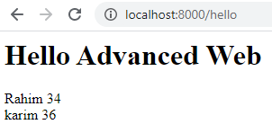
Passing array to blade Syntax in blade
Passing array
Usage of foreach loop
Output

Slide 12
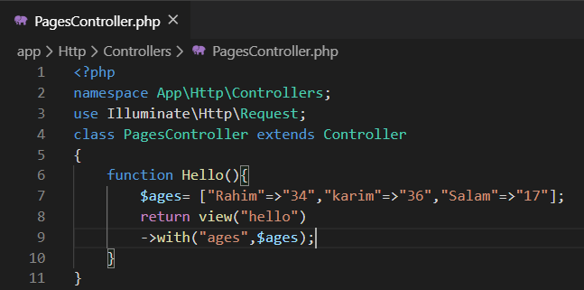
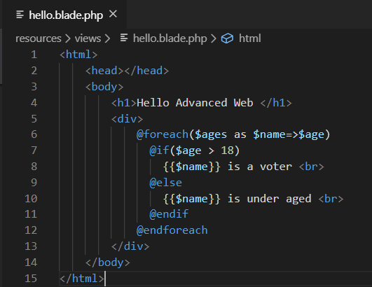
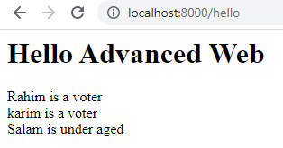
If else syntax in blade
Passing array
If else
Output

Slide 13
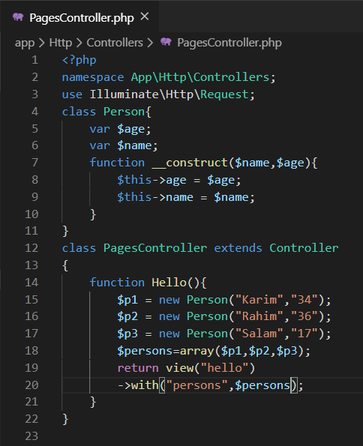
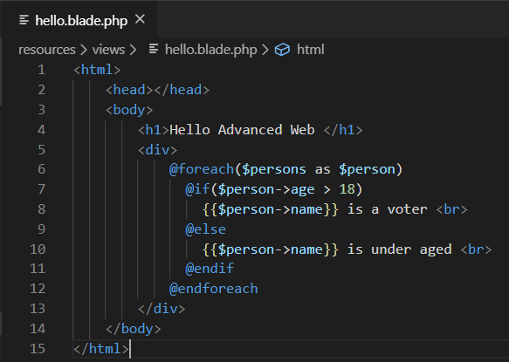
Passing object in blade and Usage
Person class
Person objects
Person objects
Output

Slide 14
Data Passing: View to Controller
In web user input data can be passed to server in 2 ways.
Form data [Get or Post]
URL parameter [Get Request]
Create a form in resources/views/registration.blade.php
Create route in routes/web.php and function in PagesController.php
Don’t forget put {{csrf_field()}} inside form
Create a post route for Submitting the form and function
function register(Request $request){
return "Submitted";
}
The function should receive a Request object which holds all the submitted value.
The submitted values are the properties of $request object.

Slide 15
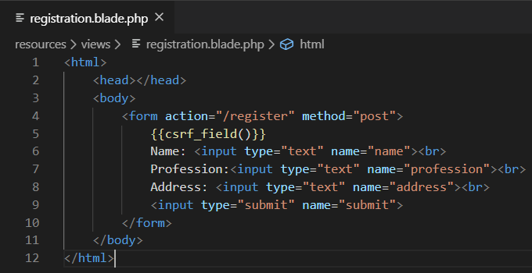
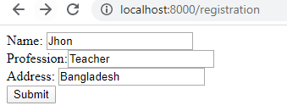
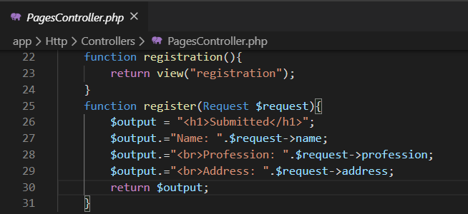
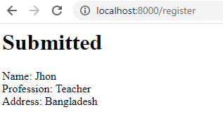
Passing value from view to Controller
Output
Output

Slide 16


Advanced Routing
Through routing you can also pass dynamic values to server.
Route::get('/user/{id}', function($id)
{
return "<b>The passed id is ".$id."</b>";
});
The value inside {} is dynamic and should be caught in function parameter to use.
You can also create like this
Route::get('/user/{id}/files/{file_id}',function($id,$fileid){
return "<b>The passed id is $id and file id is $fileid</b>";
});
Parameter
Argument
110 is passed

Slide 17

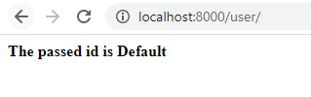
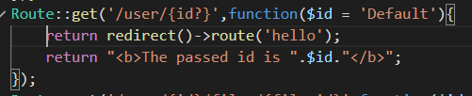
Routing parameters
should consist of alphabetic characters, and may not contain a - character. Instead of using the - character, use an underscore (_).
Previously shown parameters are mandatory parameters you must pass those parameters otherwise it will get an error.
Optional Route parameters
Route::get('/user/{id?}', function($id = null)
{
return "<b>The passed id is ".$id."</b>";
});
Optional Route parameters with default value
Route::get('/user/{id?}', function($id = 'Default')
{
return "<b>The passed id is ".$id."</b>";
});
Routes can have names to access them from the codes.
Route::get('/hello',function(){
return "Hello World";
})->name('hello');
MUST READ:https://laravel.com/docs/4.2/routing
Access with name

Slide 18
Books
PHP Advanced and Object-Oriented Programming, 3rd Edition; Larry Ullman; Peachpit, Press, 2013
PHP Objects, Patterns and Practice, 5th Edition; Matt Zandstra; Apress, 2016
Learning PHP, MySQL, JavaScript and CSS, 2nd Edition; Robin Nixon; O’Reilly, 2009
Eloquent JavaScript: A Modern Introduction to Programming; Marijn Haverbeke; 2011
Learning Node.js: A Hands On Guide to Building Web Applications in JavaScript; Marc Wandschneider; Addison-Wesley, 2013
Beginning Node.js; Basarat Ali Syed; Apress, 2014

Slide 19
References
https://www.w3adda.com/laravel-tutorial/laravel-blade-template
https://laravel.com/docs/7.x/session
https://laravel.com/docs/7.x/controllers
https://laravel.com/docs/7.x/views
https://laravel.com/docs/7.x/blade

Slide 20
Thank You!

